Slide 1
University Advancement

Slide 2
Division of University Advancement
Departments
  Advancement Services
  Alumni Relations & Annual Giving
  Development
  Donor Relations
  Sam Houston Memorial Museum & Republic of Texas Presidential Library

Slide 3
FY 2024 Accomplishments
Priority 1: Prioritize Student Success and Student Access
  Empowered Students
    Annual Faculty and Staff Campaign
      60% participation
      1,373 faculty and staff donated $258,567
    Increased Scholarships
      Scholarship distributions are up 14% over LY
      Number of scholarships awarded is up 7%
    Increased partnerships w/ corporations for internships
      Created new partnership with ORSP to better support academic and programmatic initiatives
    Alumni Ring program participation
      500+ students registered for the Spring 2024 ceremony
      600+ students participated in the Fall 2023 ceremony
    Museum focused on student success
      Museum staff mentored student workers to develop lifelong skills (professional and social)
      Museum has 100% degree completion rate for student workers
    Museum partnered with various colleges and professors for class tours and academic events
      "Art in the Park” with art classes added outdoor sculptures to Museum grounds
      Honors College class featuring a (spring) semester of student on Sam Houston
      Supported 2 student interns

Slide 4
FY 2024 Accomplishments
Priority 2: Embody a Culture of Excellence
  Process Alignment
    E-gift receipts implemented in February 2024. Resulted in cost savings on printing and postage.
      Postage savings $655 over 2-months / Approx. $4,000 a year in savings
      Printing savings approx. $2,000 a year
    Applying CASE best practices to major gift portfolio management
    Eliminating Alumni annual membership dues to fully integrate the Alumni Association with the university's strategic priorities
  Excellent Service
    Automated birthday e-mails to alumni
      Email open rate 52.1%

Slide 5
FY 2024 Accomplishments
Priority 3: Elevate the Reputation and Visibility of SHSU
  Quality Events
    Alumni Association hosted the first SH 79 Business Awards Luncheon in Fall 2023.
    Alumni Association hosted national alumni events in New York and Washington, DC.
  Increase Partnerships
    Annual Giving's partnership with SHSU Food Pantry (Nov 13-18)
      Crowdfunding campaign generated 23 gifts for $1,140
  Relationship Enhancement
    Museum hosted dozens of “artifact vault tours" for legislators, regents, and prospective donors.
  Community Engagement
    Donor Relations created “signing days” for new gift agreements. The events are shared on social media to establish a visible culture of philanthropy.
    Annual Giving implemented the first "Day of Giving" for SHSU
      April 23, 2024

Slide 6
FY 2024 Accomplishments
Priority 4: Expand and Elevate our Service to the State and Beyond
  Engagement
    Approx. 70,000 visitors at the SH Museum & Republic of TX Presidential Library
  Community Engagement
    Chamber partnerships
      Huntsville Walker County Chamber of Commerce, Conroe - Lake Conroe Chamber of Commerce, The Woodlands Area Economic Development Partnership, The Woodlands Area Chamber of Commerce, Greater Houston Partnership
    Museum hosted the Texas Living History Association annual conference
    Museum hosted community-centric events
      General Sam Houston Day
      “Sundown at Sam’s” music concert series
  Alumni Clubs
    Alumni Relations team focused on transforming regional engagement

Slide 8
FY 2025 Keep Doing
Statement: The division plans to KEEP high profile alumni events and regional chamber memberships because these events and memberships provide meaningful engagement opportunities and increase our strategic relationship with local communities. This action aligns with Priority 3: Elevate the reputation and visibility of SHSU & Establish a more visible and high-profile culture of Philanthropy, Service, and Community Engagement and will help create and foster a culture of philanthropy in achieving Pillar 4 – Agility.
Supporting Data: Local chambers provide great marketing resources (i.e.: newsletters, websites, social media, event sponsorships, etc.) and enrollment referral opportunities. Chamber memberships also provide networking and professional development opportunities for staff.
Resources / Collaborations Required: Collaboration with all university units is welcomed. All Chamber membership dues and event sponsorships are paid from UA budget.

Slide 9





Supportive Data
Harris County and Montgomery County provide the largest number of students enrolled at SHSU (freshman/transfer)
  More than 10,000 students enrolled Fall 2023 from the 2 counties
Chamber membership helps SHSU build community relationships and networking opportunities.
Chamber partnerships provide marketing and recruiting opportunities for the university.

Slide 10
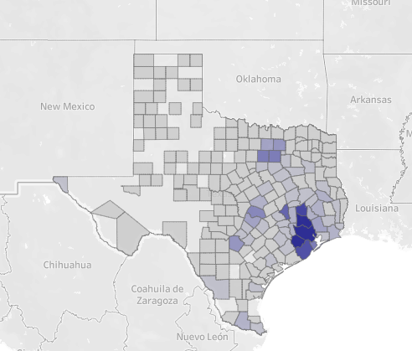
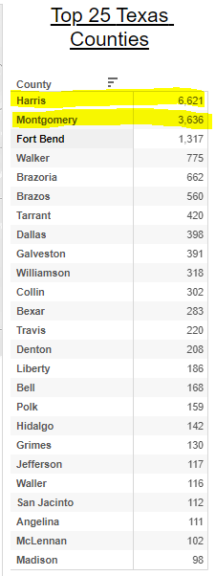
Supportive Data
SHSU Fact Book – Fall 2023 Enrollment: Geographic

Slide 11
FY 2025 Keep Doing
Statement: The division plans to KEEP the Sam Houston Memorial Museum & Republic of TX Presidential Library’s programming efforts because the programs create meaningful engagement opportunities and help build awareness of the Museum and University. This action aligns with Priority 3: Elevate the reputation and visibility of SHSU and will have positive impact connecting the public to the university in achieving Pillar 1 - Enrollment.
Supporting Data: The Sam Houston Memorial Museum & Republic of Texas Presidential Library is the “front porch” of the university, creating recruiting and enrollment opportunities for prospective students and families.
Resources / Collaborations Required: New partnership with Enrollment Success (i.e. Visitor Center, JR. Bearkats) to promote recruiting opportunities.

Slide 12



Slide 13
FY 2025 Stop Doing
Statement: The division plans to STOP Alumni annual membership dues because annual memberships create donor confusion and increase the number of asks from SHSU. Asking for specific dollar amounts creates a barrier to increased giving and philanthropic engagement. This action aligns with Priority 3: Elevate the reputation and visibility of SHSU and will have an increase in alumni engagement and help in achieving Pillar 4 - Agility.
Supporting Data: Data shows that people under 40 are no longer joining membership organizations. Many universities have cut the traditional alumni association model and replaced it with a new networking model. All graduating students will now be “members” of the Alumni Association with a new emphasis on “Lifetime Membership” which will provide alumni access to career connections, networking opportunities, and special events.
Resources / Collaborations Recovered: Eliminating mass mailing for annual membership dues will help reduce the annual spending on print/postage.

Slide 14
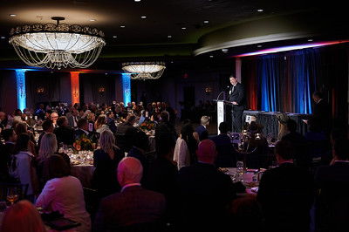



Slide 15
FY 2025 Stop Doing
Statement: The division plans to STOP hosting alumni/donor events that limited or no ROI because these events do not support the vision of stewardship and do not align with the new plans of Advancement. This action aligns with Priority 3 – Elevate the reputation and visibility of SHSU and will have a more effective use of expenditures in achieving Pillar 4 - Agility.
Supporting Data: Events will be strategically planned and organized with a purpose. Simple attendance will no longer be a KPI for UA-events; instead, KPIs will be focused on relationships and stewardship for future return/investment at SHSU. (Events like Face-to-Face Scholarship Luncheon, Alumni Lifetime Member Dinner, Distinguished Alumni Gala, and the Sam Houston 79 business awards luncheon will continue.)
Resources / Collaborations Recovered: Eliminating specific events that have no ROI will help reduce expenditures in event expenses (catering, decorations, invitations, etc.).

Slide 16
FY 2025 Stop Doing
Statement: The division plans to STOP mass mailings (i.e. gift receipts, appeals, invitations) because technology allows for more effective ways to communicate with alumni and donors. This action aligns with Priority 3 – Elevate the reputation and visibility of SHSU and will have more effective uses for expenditures in achieving Pillar 4 - Agility.
Supporting Data: Eliminating mail doesn’t mean all communication will end, nor does it mean we will over-send communication via email. Instead, UA will use technology/AI to strategically communicate with its constituents. An emphasis on newsletters, social media, calendars/newsfeeds, will be enhanced.
Resources / Collaborations Recovered: Eliminating mass mailing for gift receipts, appeals, and invitations will help reduce the annual spending on print/postage. The expenditure will be better used on AI technology (i.e. EverTrue, Scalefunder). Approximately $100,000 is needed for new software purchases (annually).

Slide 17
Supportive Data

Slide 18
FY 2025 Start Doing
Statement: The division plans to START a Leadership Annual Giving Program because it will bridge the gap between annual giving and major gifts. This action aligns with Priority 3: Elevate the reputation and visibility of SHSU and will have a positive impact in creating a vetted giving pipeline for Development Officers in achieving Pillar 4 - Agility.
Supporting Data: See next slides.
Resources / Collaborations Required: Budget for new Leadership Annual Giving Officer positions (2) is required; approximately $67,000 in salary/benefits is needed per position.

Slide 19
Division of University Advancement
FY 2024 Fundraising Efforts
  As of April 5, $17.2M raised of $23M goal
  Current fundraising staff
    6 FT staff
  Fundraising needs of university
FY 2025 NEED
  Leadership Annual Giving program
    Open prospects from 1% to 3%

Slide 20
Division of University Advancement
Current UA Fundraising Structure
Major Donors
Annual Giving
Development Officers
- Currently responsible for gifts of $1,000+
Annual Giving
- Responsible for gifts of $1 - $1,000

Slide 21
Division of University Advancement
Future Fundraising Structure
Major Donors
$25,000+
Annual Giving
$1 - $1,000
$1,000 - $24,999
Development Officers
PIPELINE GAP:
Prospects are currently not being engaged
*NEW*
Leadership Annual Giving Officers
Annual Giving
Call Center
Alumni Relations

Slide 22
Leadership Annual Giving Program
The benefits:
Allows MGO’s to focus on portfolios where prospects have higher MG affinity scores.
Thusly, Builds future MG pipelines
Encourages loyal donors that do not have wealth to participate
Creates a smooth transition in the integrated advancement continuum
Guarantees sustained support for the institution with Cash in the door

Slide 23
Division of University Advancement
KEEP DOING
  Keep high profile alumni events and regional chamber memberships
  Keep Museum's programming efforts
STOP DOING
  Stop Alumni annual membership dues
  Stop events that have limited ROI and stewardship
  Stop mass mailing across the division
START DOING
  Start Leadership Annual Giving program

Slide 24
Questions?

